Slide 1

CARRICKFERGUS ACADEMY
YEAR 8 PARENTS’ INFORMATION EVENING
28 SEPTEMBER 21

Slide 2
Key Points
Tracking Your Child’s Progress
Homework
Google Classroom
SIMs Parent App

Slide 3
Tracking Your Child’s Progress
Ongoing assessment through homework and other assessments but, there are four key assessment points throughout the year
  OCTOBER (CLASS TEST WITH TRACKING REPORT)
  DECEMBER (CLASS TEST WITH TRACKING REPORT)
  MARCH (CLASS TEST WITH TRACKING REPORT)
  MAY (SUMMER EXAM WITH ANNUAL REPORT)
At each stage, you will receive your child's performance based on a stanine or level between 1-9 for all subjects – via SIMs App
You will also receive information on attendance and behaviour
Parents / Subject Teacher Meeting will be in April

Slide 4
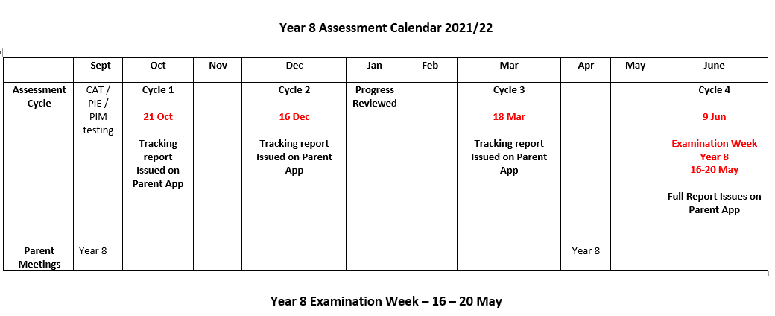
Assessment Cycle

Slide 5
Tracking Your Child’s Progress
You have received your child’s :
  National CAT Stanine
  Progress In English Stanine
  Progress In Maths Stanine
Your child is in a streamed class based on their score for their CAT test
We have set your child a target stanine or level based on their CAT stanine.
Students are expected to perform at their target or , for some above. We have built in opportunity for stretch and challenge in the target grades we have set.

Slide 6
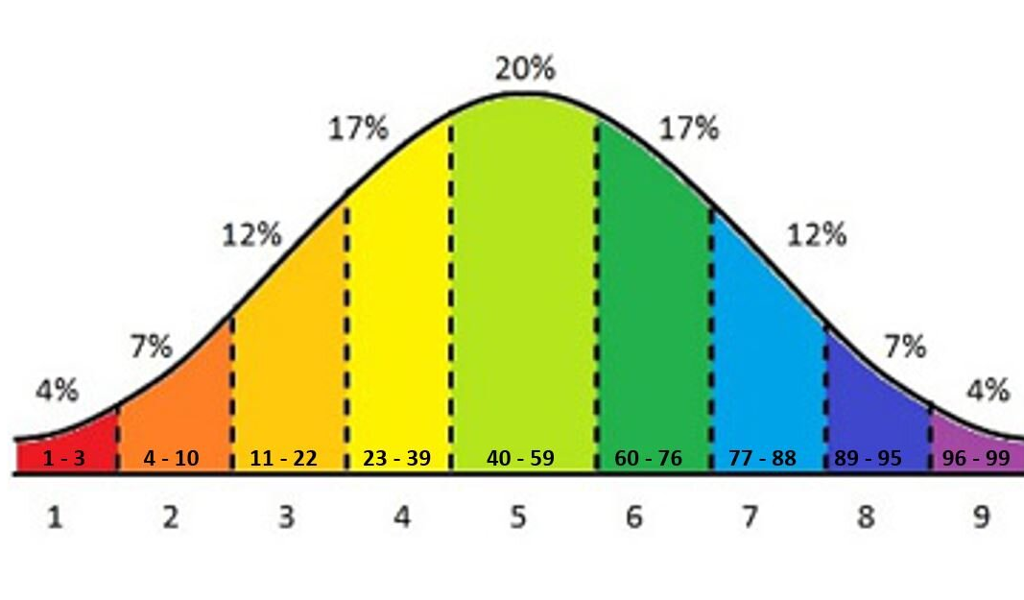
How do Stanines work?

Slide 7
Key Points
Students will undertake common but differentiated assessments at each key tracking point
We will review progress and class placement after Tracking 2
We will re-test all Year 8 students at the end of the year in Progress in Maths and English – you will be given the outcomes.
At the end of Year 8, performance in Key Subjects in Summer Examinations will be taken into account along with CAT Stanine on entry to re-stream classes for Year 9.

Slide 8
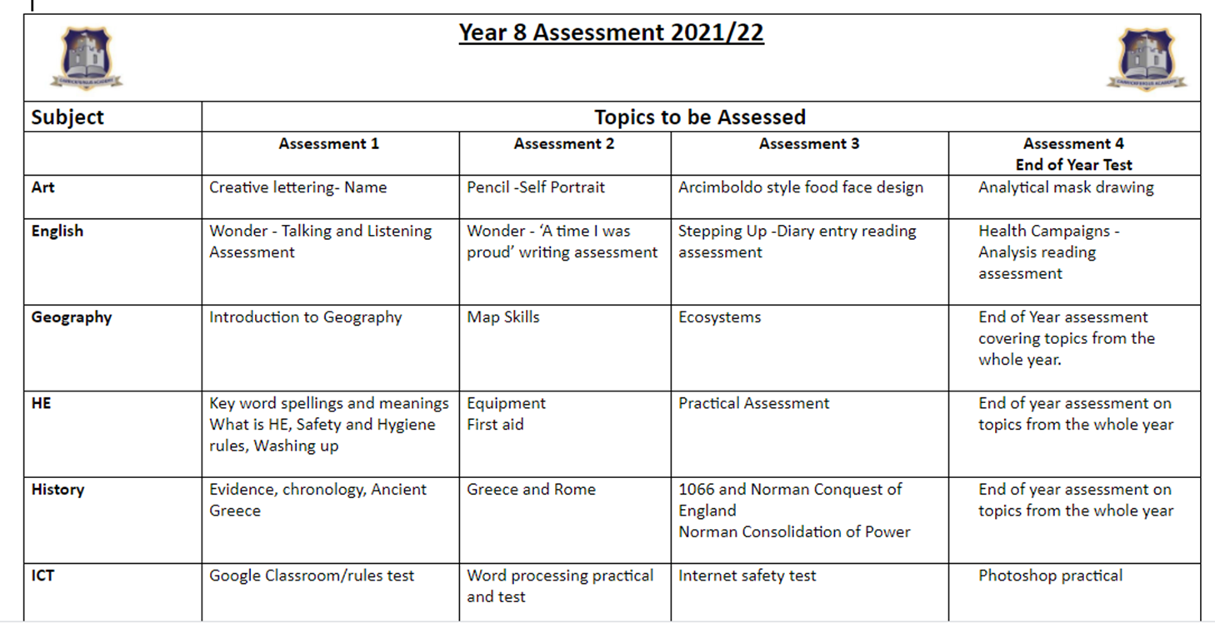
What will your child be assessed on?

Slide 10
ICT | Google Classroom/rules test | Word processing practical and test | Internet safety test | Photoshop practical
Maths | Unit 1 - Statistics | Unit 2 - Symmetry Unit 3 - Number | Unit 4 -Shape Unit 5 - Decimals | Unit 1-5 from throughout the year Unit 6 - Probability Unit 7 - Angles
Music | Up and Down - keyboard assessment and ‘Listen In’ assessment | Instruments of the Orchestra listening assessment Winter Composition | Rap composition and assessment 4 Raps - listening assessment | Three Little Birds - keyboard assessment Volcano composition
PE | Practical unit: Games For Understanding (All pupils) | Practical unit: Girls - Badminton Boys - Parkour | Practical unit: Girls: Gymnastics & Health Related PE Boys:Basketball & Badminton | Practical unit: Athletics (All pupils)
RE | Unit 1 Bible | Unit 2 Abraham | Unit 3 Moses | End of year test on all topics: The Bible, Abraham, The story of Moses
Science | Introducing Science booklet - revise pages 1-18 | Cells booklet - up to and including classification | Materials booklet - revise up to and including density | End of year exam; revise all four booklets (introducing science, cells, materials and forces)
Spanish | Greetings | Alphabet & Numbers 1-31 | In class | End of year test on a range of topics.
Technology | Keyfob - Practical and Test | Disney- Practical and Test | Stationary- Practical and Test | End of year test

Slide 11

Homework
Differences from Primary School
How much is set?
When is it set?
When is it due?

Slide 12
Why set Homework?
Work set to
  Complete classwork
  Build on what is learnt
  Prepare for next class
  Research
  Revise
  Prepare for tests

Slide 13
How does the school support us?
Contact teachers – GC, phone, email
Homework Club – Wednesday 1 hour
Extended Schools Programme – Focus on Homework
  3 days a week
  Monitor homework - monthly study clinics
Free Word, Excel, PowerPoint etc.

Slide 14
What can we do as parents?
Dedicated space – kitchen table
Have a homework time – immediately home, before tea, after tea
Be aware of what is set – none one day but may have 5 next day
Let us know if there are reasons why it cannot be done

Slide 15
Google Classroom
Demonstration
Mrs Magill

Slide 16

Pastoral
Pastoral Staff, Youth Services, YMCA, Independent Counselling, Special Educational Needs provision, Sense Room, HUB Room, Mentoring, Engage

Slide 17


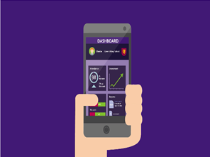
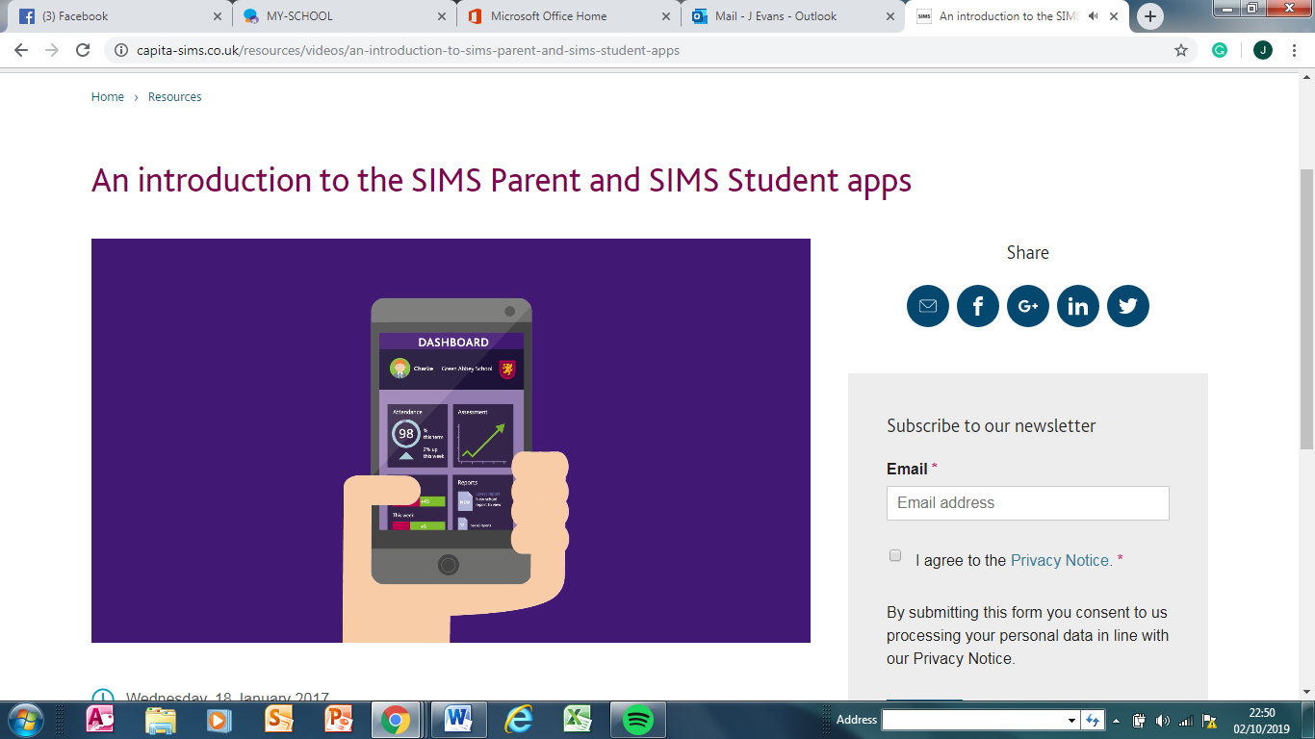
Sims Parent App
@
Carrickfergus Academy
Notes:
How many people have parent app

Slide 18

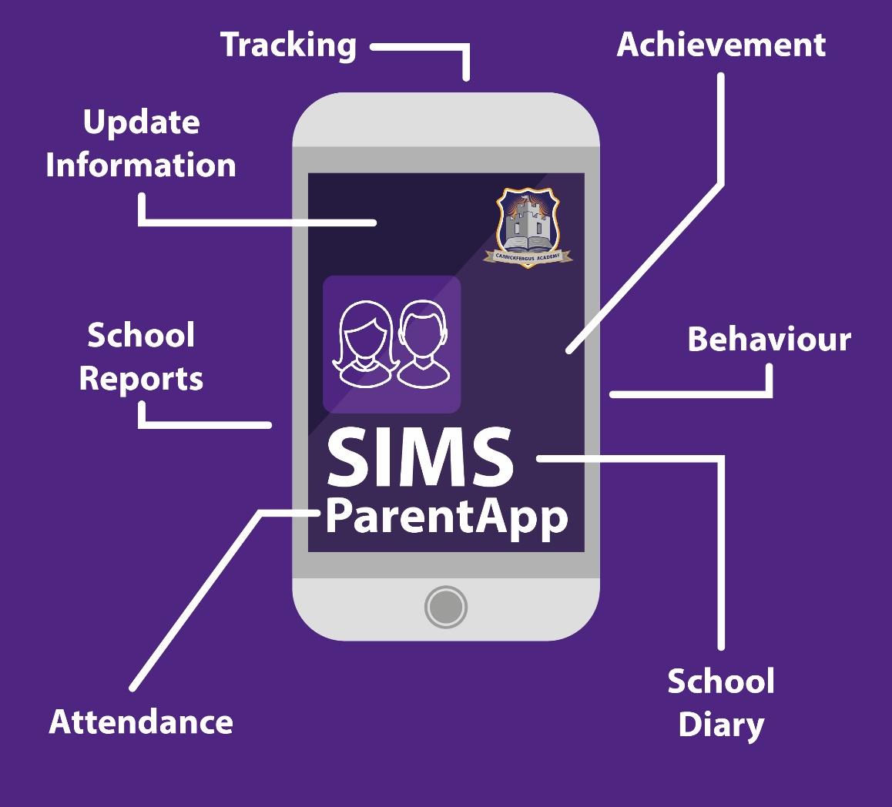
What is Parent App?

Slide 19
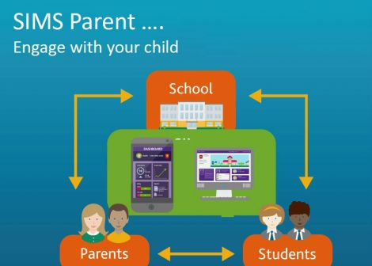
Parent Engagement

Slide 20
Why Parent App?
The SIMS Parent app allows schools:-
To easily communicate with parents, quickly and effectively
Improve efficiency
To engage parents in all aspects of their child's school life via smart phone, tablet or PC
  Attendance
  Behaviour
  Reminders
  Automated alerts
  Information on Extra-curricular
  Timetable
  Reports
  Assessment
To get the parents more involved in real time so they can monitor their child’s progress, attendance and receive important alerts and information
To work with parents to improve outcomes for their children.

Slide 21

What happens if parents already have Parent App
If they already have Parent App don’t panic, they just accept Carrickfergus Academy invitation and follow the instructions, make sure that they log in using the same log in as they first registered their first child and then they will be able to see all children on the one app.

Slide 22
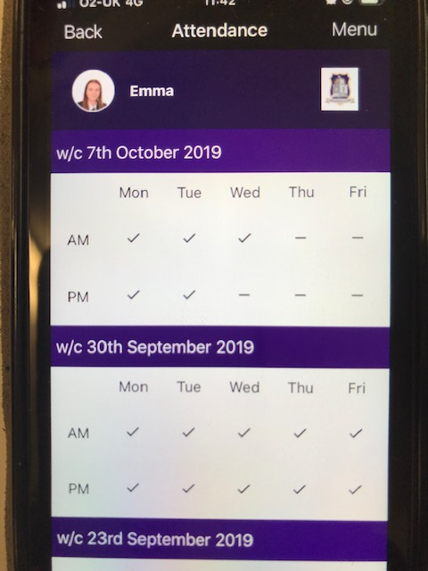
What will I see on my phone?
Attendance
Parents can see the attendance for their child, morning and afternoon in real time.
They will also receive a summary report every Friday evening.

Slide 23
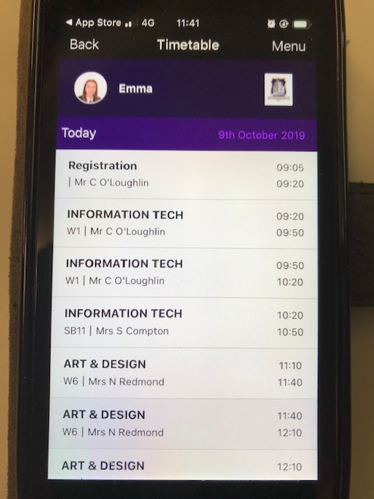
What will I see on my phone?
Timetable

Slide 24
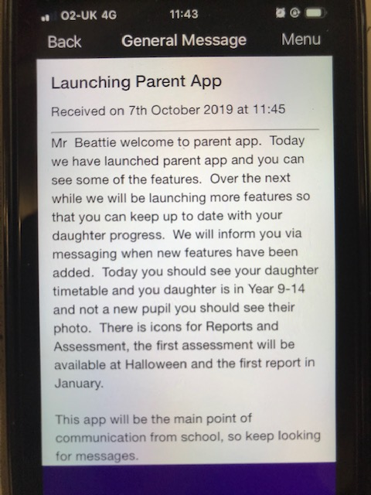
What will I see on my phone?
Messages
Message will be push notification like a text message or a WhatsApp.
Parents will get a notification if they allow notifications on their phone when a message has been sent.
However it will always be in their messages section.

Slide 25
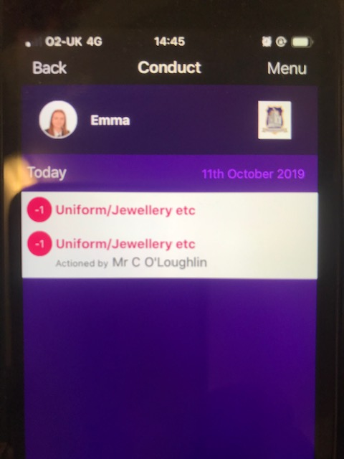
What will I see on my phone?
Behaviour
This will appear on the phone as shown opposite.
Make sure that all behaviours are actioned by …..

Slide 26
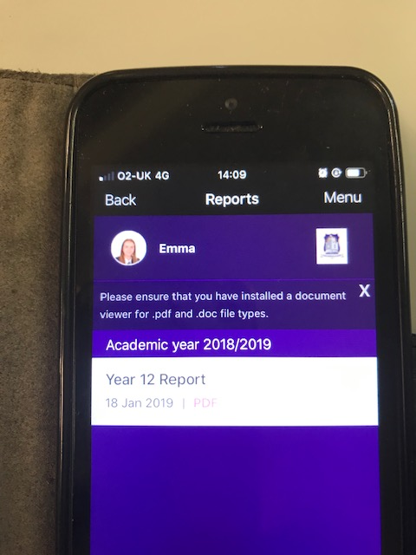
What will I see on my phone?
Reports

Slide 27
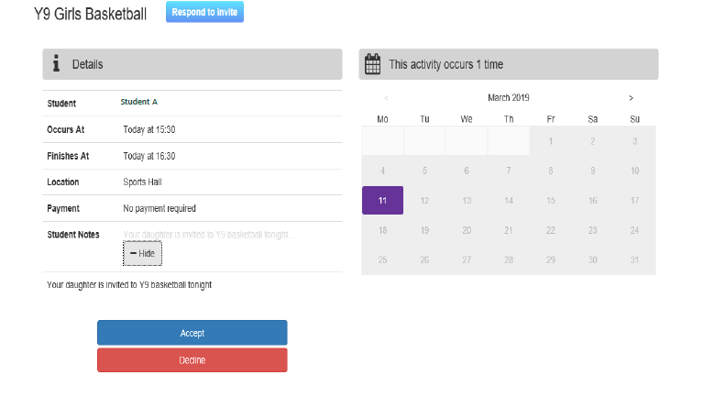
What will I see on my phone?
School Calendar
  keys dates and events
School Activities
Positive Achievement

Slide 28
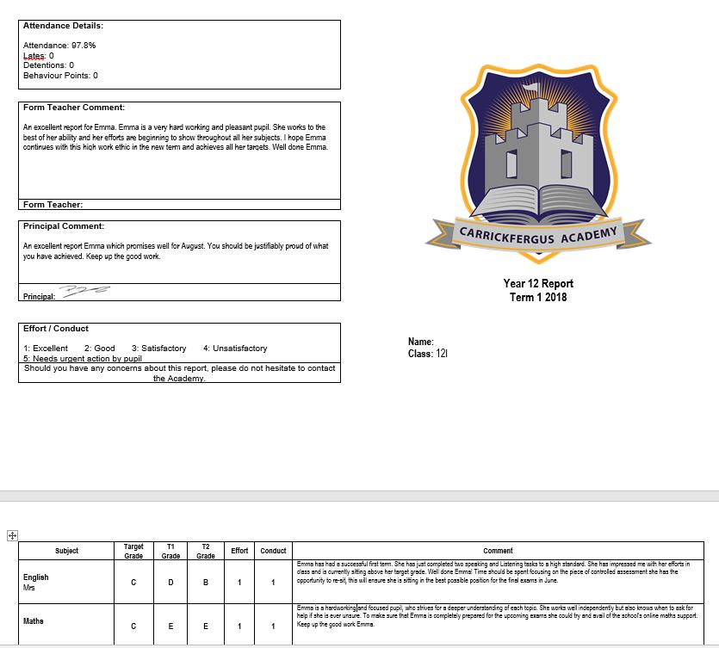
What will I see on my phone?
Reports

Slide 29
What will I see on my phone?
Reports

Slide 30
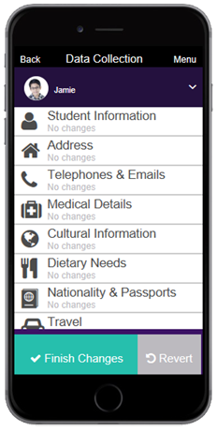
What will I see on my phone?
Data Collection
You can keep your details up-to-date
You can update it anytime of the day or night
You will receive a response when the school has updated this information
Everything is confidential as it comes directly from the parent app which has been register to the parent
This will take away the school data capture form sent out each year

Slide 31
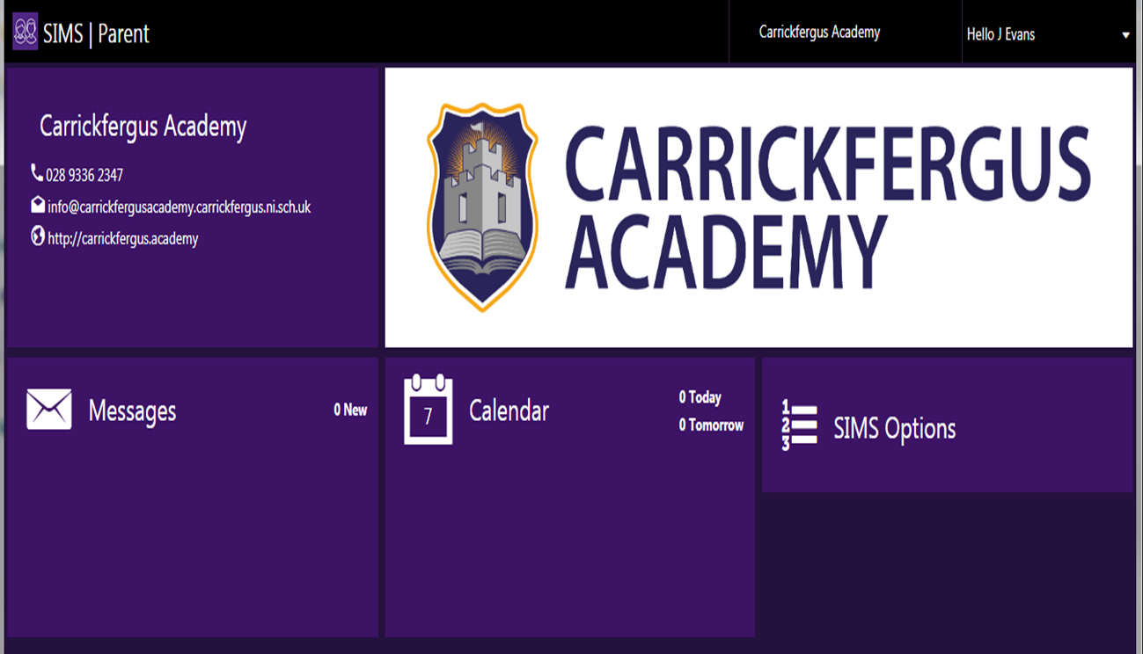
What will I see on my PC?

Slide 32
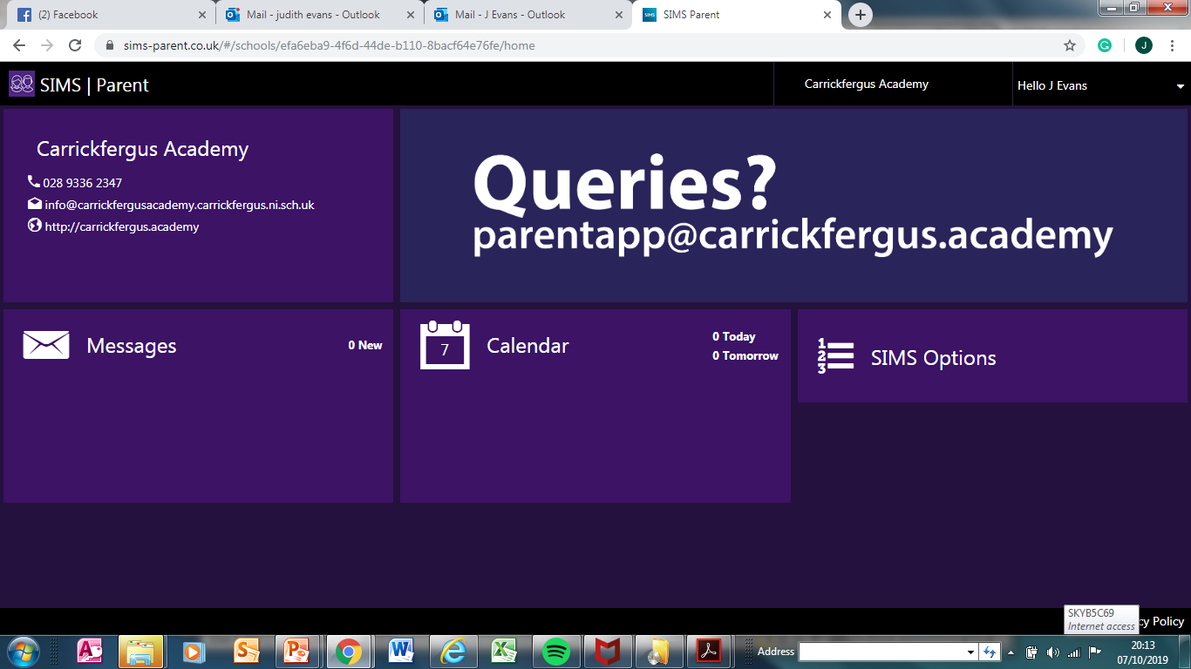
What will I see on my PC?
caparentapp@outlook.com

Slide 33

Video on Parent App?
https://www.capita-sims.co.uk/resources/videos/sims-parent-app-parents-view

