Slide 1
GCSE Subjects in Home Economics

Slide 2
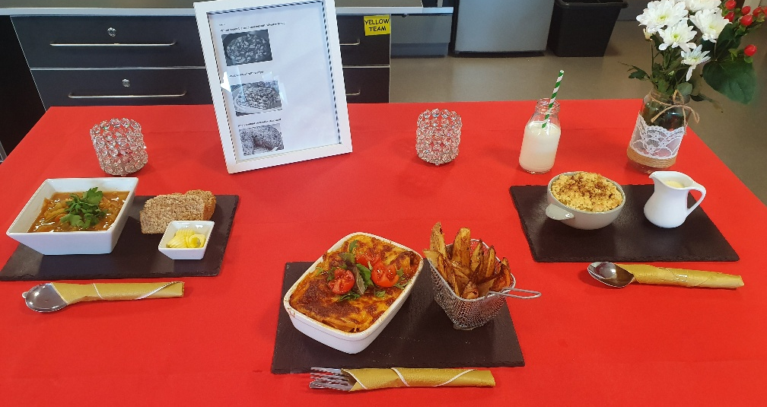
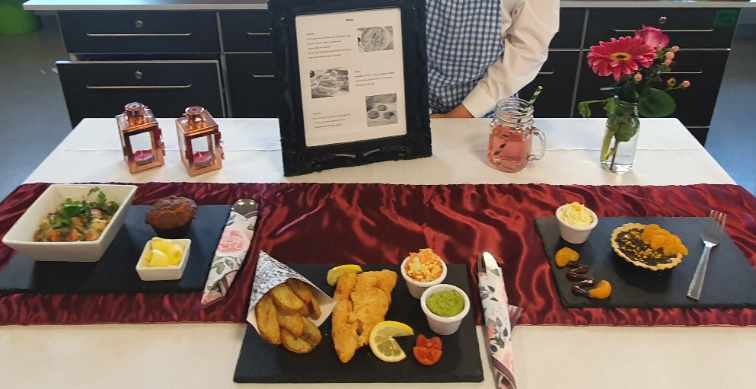
GCSE Food
and Nutrition

Slide 3
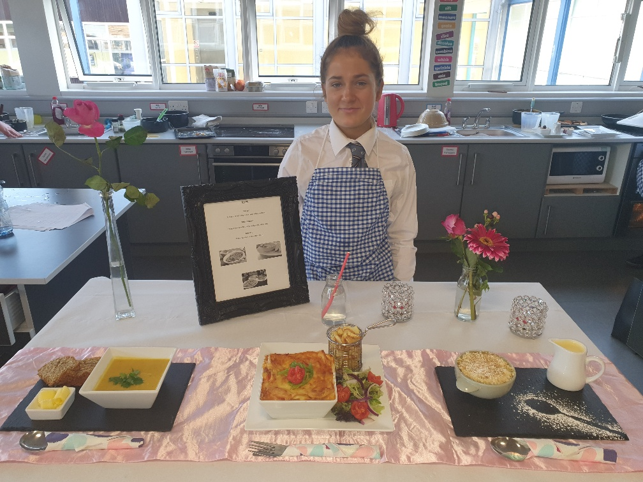
What will I learn about?
Food and Nutrition encourages students to develop knowledge and understanding of the science behind food.
Food Safety
Macro Nutrients
Food Processing and Preservation
Government nutritional guidelines
You will also have the chance to develop practical skills in food preparation, cooking and presentation.
Food Provenance
Micro Nutrients
Notes:
Key areas:

Slide 4
Assessment breakdown…

Slide 5
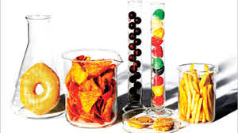
Who should consider choosing this subject?
Those who enjoyed Home Economics and Science at Key Stage Three.
Those interested in health issues associated with dietary and lifestyle choices, the factors affecting how we buy food, what we buy, what we waste and planning meals for people with specific nutritional and dietary needs.
Those with a high level of practical food preparation skills.

Slide 6
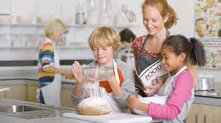
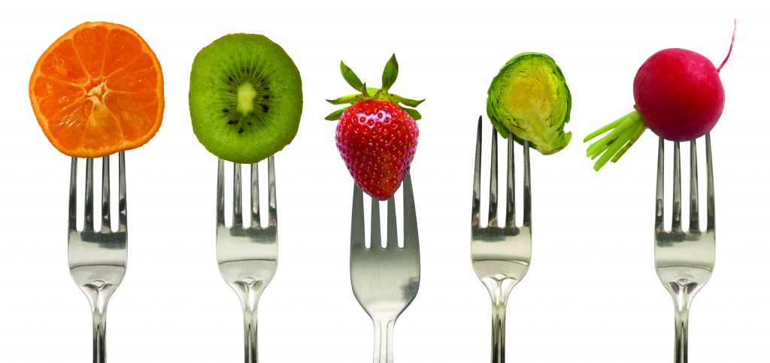
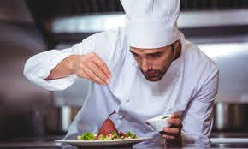
Career Options:
Teacher
Nurse
Dietitian
Chef
Environmental Health officer
Product Development

Slide 7
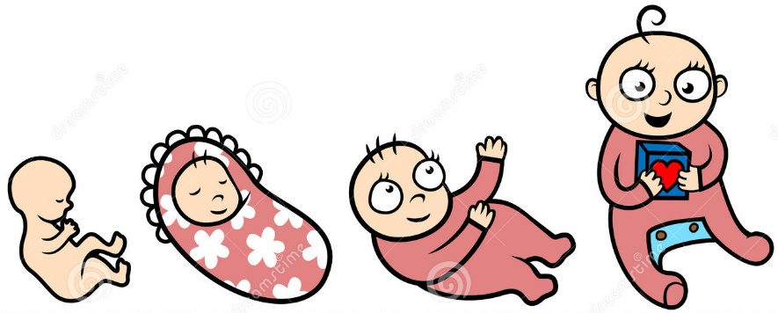
GCSE Child Development

Slide 8
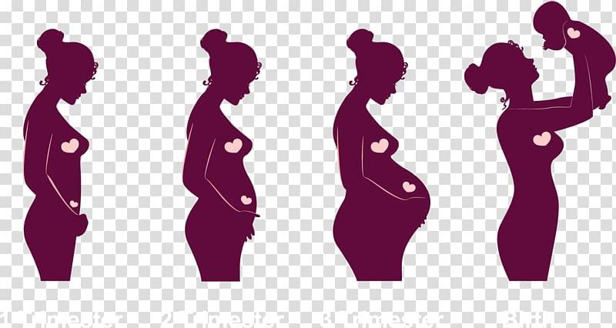
What will I learn about?
Reproduction, pregnancy and the newborn baby
The development of small children including their dietary, health and educational needs
The responsibilities involved in parenting and other family roles

Slide 9
Assessment breakdown…
Unit 1: Parenthood, Pregnancy and the Newborn baby
- Exam at end of Year 11
- Worth 30% of overall GCSE
Unit 2: The Development of the Child (0-5 years)
- Exam at end of Year 12
- Worth 30% of overall GCSE
Unit 3: Investigation Task
- Controlled Assessment completed in Year 12
- Worth 40% of overall GCSE
2 examination papers = 60%
1 controlled assessment task = 40%

Slide 10
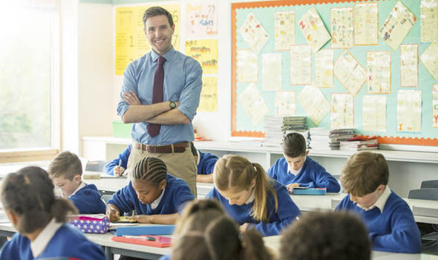
Who should choose Child Development?
Pupils who enjoy Home Economic, Biology or would like to work as a…
Primary School Teacher
Nursery Teacher/Assistant
Nurse
Midwife

Slide 11
OCN – Early Years, Child Care
and Development
New subjects!
OCN – Vocational Skills
in Diet, Food and Hospitality

Slide 12
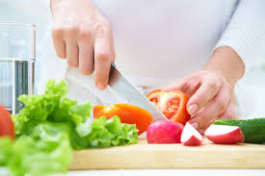
OCN – Diet, Food and Hospitality
What will I achieve?
After successfully completing this subject you will achieve an equivalent to a grade B at GCSE.
What will I learn?
We will cover topics that will prepare you for employment in the hospitality industry and consider how consumers should make healthy diet choices for example:
Practical cooking skills
Customer service
Food and nutrition
Safety and hygiene

Slide 13
How will I be assessed?
This subjects is assessed 100% by portfolio work. That means you do not have to sit an exam.
You will have to complete 5 portfolio’s over the 2 year course
Some of these will include practical assessments.

Slide 14
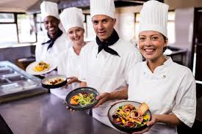
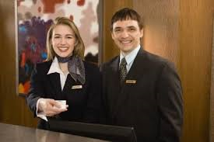
Who should choose this subject?
Someone who
Enjoys cooking and has good practical skills
Enjoys Home Economics
Has an interest in the hospitality sector
Wants to learn more about how we can make healthy food choices.
Careers include
Chef Waiting staff Working in a hotel

Slide 15
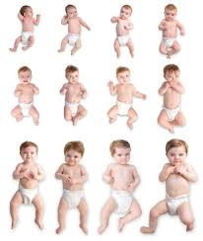
OCN – Early Years, Child Care and Development
What will I achieve?
After successfully completing this subject you will achieve an equivalent to a grade B at GCSE.
What will I learn?
How a child develops
How to meet the child’s needs
How to care for the child

Slide 16
How will I be assessed?
This subjects is assessed 100% by portfolio work. That means you do not have to sit an exam.
You will have to complete 5 portfolio’s over the 2 year course
Some of these will include practical demonstrations and role plays on how to care for a child.

Slide 17
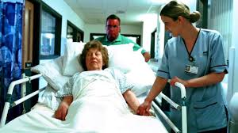
Who should choose this subject?
Someone who
Enjoyed Home Economics at KS3
Has an interest in understanding how to care for a child
Wants to pursue a career working with children
Careers include
Learning support/ Working in a day care/ Health care support worker
Classroom assistant Child minder

Slide 18
Questions you might have…..
What foods will I cook in Food Nutrition?
You will have the opportunity to produce a range of meals including Risotto, Chow Mein, Sweet and Sour, Swiss Roll and Sausage rolls
Is there any cooking in Child Development?
No
How much written work will I have to do?
Like all GCSE’s you will complete a variety of classwork, homework and topic tests in preparation for your GCSE exams.
The OCN qualifications all the written work completed is what will be used as evidence for your assessment.
How many GCSE grades is each subject worth?
Both Food Nutrition and Child Development are worth 1 GCSE grade.
The OCN subjects are an equivalent to a B grade at GCSE

Slide 19
The Food and Drink industry is
Northern Irelands largest manufacturer
Invest NI

Slide 20
If you have any questions…
Ask your Home Economics teacher

