Slide 1
Welcome to Carrickfergus Academy
JUNE 2022
Notes:
Paula - Welcome everyone this morning but in particular our new year 8 pupils to your new school.

Slide 2
Your New School
Key Staff
August / September Induction
Class Placement
Assessment
Curriculum
Timetable
Uniform
Pastoral
Notes:
Paula

Slide 3
Senior Leadership Team
Deputy Principals
Mr C Patterson Mrs A Irvine
Senior Teachers
Mr J McCready Mrs H Boyd Mr M Gannon Mrs K McKeown Mr M Kidd Mrs J Evans
Notes:
Paula

Slide 4
Year 8 Pastoral Team
Teacher Mentors: Miss W Davis, Mr J Carlisle & Mrs S Walters
Senior Teacher Pastoral: Mrs K McKeown
SEN and AEN: Mrs H Boyd
Deputy Principals: Mrs A Irvine (Pastoral)
Mr C Patterson (Curriculum)
Principal: Dr P Downing
ALL STAFF!
Notes:
Paula

Slide 5
INDUCTION AUGUST/SEPTEMBER
Friday 26thAugust - alphabetical order (timings based on information on transition booklet) & Wednesday 31st August 9.05 – 12.10
No buses or canteen. Please bring break on the Wednesday
Welcome, Routines and Procedures in form class
GL CAT assessment completed – baseline testing to allow streaming into base classes will take place on the Friday.
Communication home to highlight streamed class first two weeks of September
Full Day 1st September
Further information session on assessment for parents with Year Mentors and Senior Teacher Assessment in early September
Notes:
Judith

Slide 6
Classes, Streaming & Progress Check Points
Classes will be streamed according to ability C / A / R / I / K / F
Based initially on GL CAT4 standardised tests
Four key assessment points across the year – review of class placement
Year 8 Information Evening – Monday 12 September 2022
Year 8 Parents Night Thursday 20 April 2023
Sept | Oct | Nov | Dec | Jan | Feb | Mar | Apr | May | June
Baseline Testing | Mid / Late Oct Tracking 1 | Target Setting | Mid Dec Tracking 2 | Target Setting |  | Early March Tracking 3 | Target Setting |  | Late May / Early June Examination Week Tracking 4
Notes:
Judith

Slide 7
Baselining & Assessment
GL CAT 4 STANDARDISED TESTS
(CAT4 - GL Assessment (gl-assessment.co.uk)
GL Standardised Test – PIM - ‘Progress in Maths’ and PIE - ‘Progress in English’ – completed early September – parents will access this data via the Sims Parent App
(Progress Test in English - GL Assessment (gl-assessment.co.uk)
Formal Class Assessment at Tracking 1, 2 and 3 – parents will access this data via the Sims Parent App
Summer Examination Tracking – FULL Report through SIMs App
Ongoing class assessments and homework throughout the year
Notes:
Judith

Slide 8
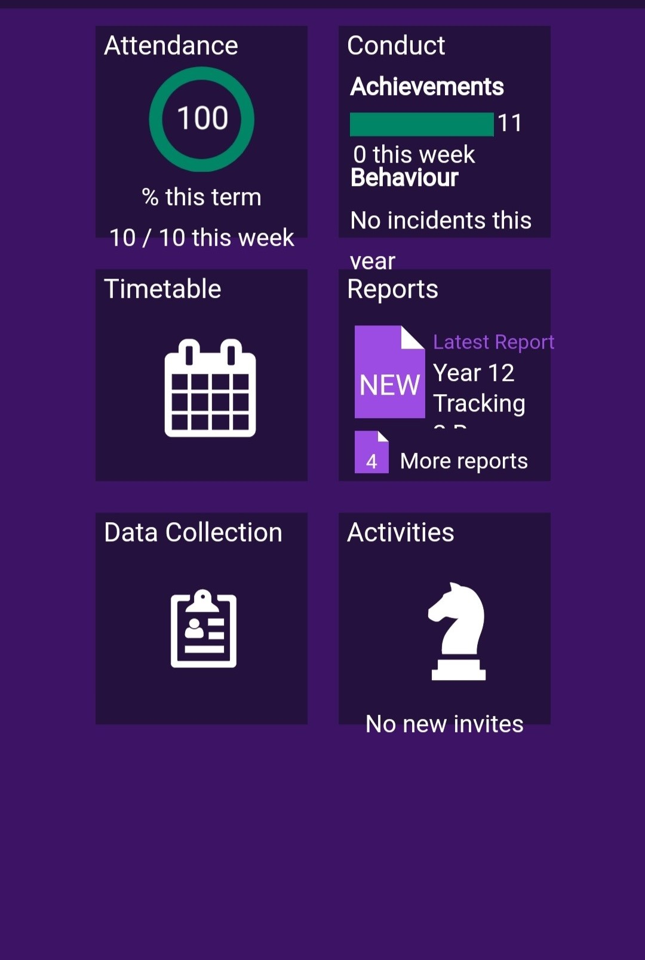
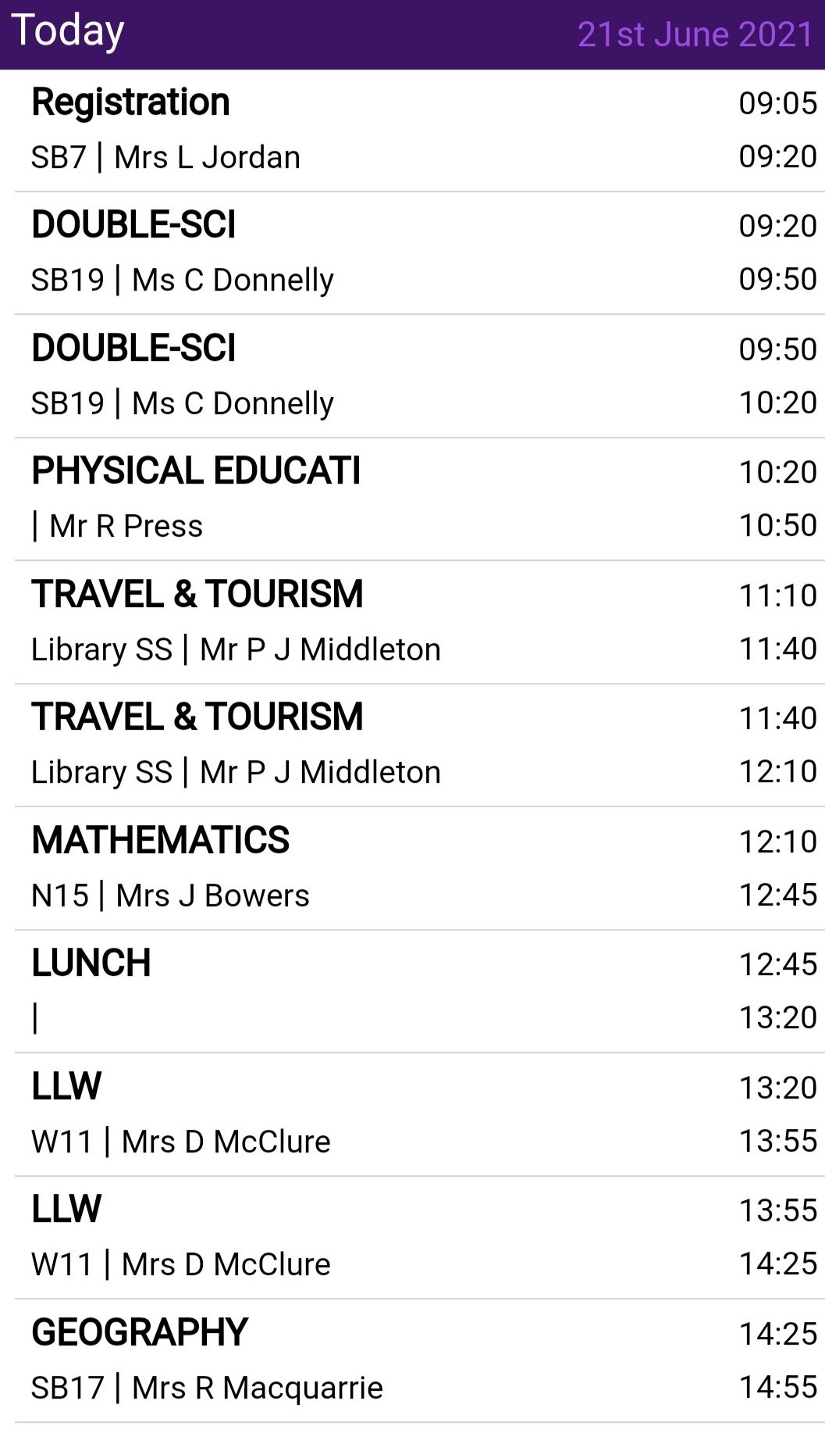
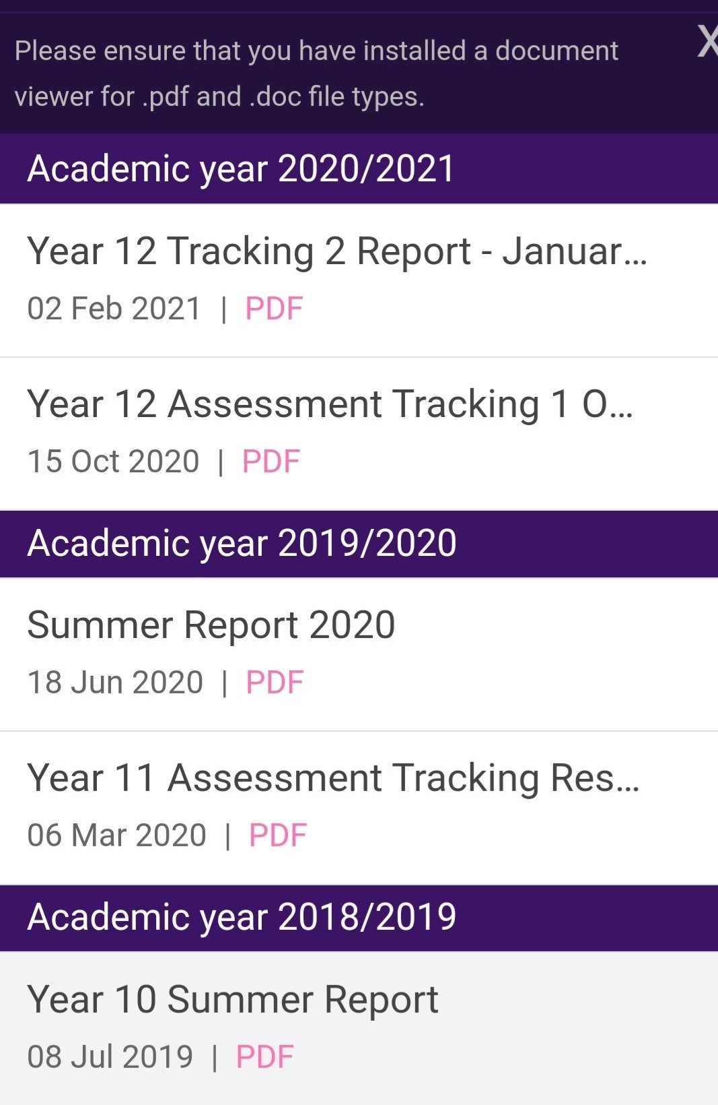
SIMs Parent App
Notes:
Judith

Slide 9
Day Structure
Reg: 9.05 - 9.20 (15 mins)
Period 1: 9.20 – 9.50 (30 mins)
Period 2: 9.50 - 10.20 (30 mins)
Period 3 10.20 – 10.40 (Break) (20 mins)
Period 4: 10.40 - 11.00 (20 mins)
Period 5: 11.00 - 11.20 (20 mins)
Period 6: 11.20 - 11.40 (20 mins)
Period 7: 11.40 – 12.10 (30 mins)
Period 8: 12.10 - 12.45 (Lunch) (35 mins)
Period 9: 12.45 - 1.20 (35 mins)
Period 10: 1.20 - 1.55 (35 mins)
Period 11: 1.55 – 2.25 (30 mins)
Period 12: 2.25 – 2.55 (30 mins)
Period 13: 2.55 – 3.25 (30 mins)
TEACHING WEEK
Monday 9.05 – 3.25
Tuesday 9.05 – 3.25
Wednesday 9.05 – 2.25
Thursday 9.05 – 3.25
Friday 9.05 – 3.25
Notes:
Mark G

Slide 10
English & Literacy
Maths & Numeracy
Science
Art
Business Studies
Drama
Games
Geography
History
Home Economics
ICT
Learning for Life & Work
Music
PE
Religious Education
Spanish
Technology
Subjects Studied Teaching
Week
Notes:
Mark G

Slide 11
SEN
Additional Educational Needs Team – Two SENCOs – one junior and one senior campus. Additional qualified SENCO to oversee Access Testing
Engage for support in English and Maths
Accelerated Reader and Accelerated Maths
Sense Room
Notes:
Helen

Slide 12
Support - Medicine
In your parent pack you received a medical form. You only need to complete this if your child has medication that they need to take in school
Please bring this medication to school with your child in August
Please make us aware this evening of any significant medical needs. Deputy Pastoral Leader overseeing medical needs on Junior site is Mr Andrews, but speak to any of us this evening
Notes:
Ian

Slide 13
Attendance
‘Miss School – Miss Out’
Target attendance and punctuality
What if my child doesn’t want to go to school?
SIMS Parent App – per term
Explaining your child’s absence
Sign Out – if pupils are leaving during the day they must sign out at the office with parental permission
Recognising and rewarding good attendance
Notes:
Ian

Slide 14
Support
Form Time – Form Mentor and Year Mentor
Counselling
Mentoring (YMCA, Vineyard)
NEGC Outreach
Youth Services provision in school for individual pupils and groups
HUB support
Notes:
Amanda

Slide 15
Boys Uniform
Boys School Uniform | Boys PE Uniform
School Blazer Plain black trousers Plain white shirt School Tie (Junior Yrs 8-12) Black leather shoes Black or grey socks (not football socks) School scarf (optional) Plain grey V-neck jumper (optional) | School rugby shirt School plain black shorts School PE socks School hoody School round neck T-shirt Training shoes – no canvas Football boots Shin guards and gum shield Plain black tracksuit bottoms – no stripes or large logos
Notes:
Amanda

Slide 16
Girls Uniform
Girls School Uniform | Girls PE Uniform
School Blazer Plain grey kick pleat skirt (2 pleats front and back worn to the knee) Plain white Blouse School Tie (Junior Yrs 8-12) Suitable black shoes (platform, high heels trainer like shoes or flimsy fashion shoes are not acceptable Opaque black tights or white knee Plain grey V-neck jumper (optional) School scarf (optional) | School polo shirt School PE socks School hoody Training shoes – no canvas School Skort - compulsory only for those representing school teams Plain black leggings / Plain track suit bottoms – no stripes or large logos
Notes:
Amanda

Slide 17
Uniform - Key Points
Hair styles should be neat and tidy. Only natural hair colourings are permitted
Make up should not be worn in Years 8-10
Pupils are permitted to wear a pair of small plain gold or silver studs, one stud in the lobe of each or either ear
Students are expected to wear full and correct uniform including to and from school
Appropriate footwear whether for general school shoes or Games / PE is essential. Pupils wearing canvas ‘converse’ type trainers will not be permitted to do PE / Games
The official suppliers of the School uniform are:-
Cuddy’s, 18-20 Marketplace Carrickfergus
Gary’s, 1 North Street Carrickfergus
Gordon’s, 10A Green Street Carrickfergus
Jeanius, De Courcey Centre Carrickfergus
Notes:
Amanda

Slide 18
http://www.eani.org.uk/i-want-to/fsm/
Apply for Free School Meals / School Uniform / Physical Education Clothing Allowance
The Education Authority (EA) is responsible for assessing eligibility for Free School Meals based on Department of Education (DE) criteria
Click on link below for further details:-
https://www.eani.org.uk/financial-help/free-school-meals-uniform-grants/free-school-meals-uniform-grant-eligibility
Notes:
Amanda

Slide 19
Key Points – COVID related
At the present time, guidance has not changed and pupils must wear School PE kit to school on the days that they have Games / PE – subject to change
Have washable school bags – rucksack type
Notes:
Amanda

Slide 20
Pastoral Care
Pastoral care and EHWB are not separate but complementary
To give your children Outstanding Pastoral Care we need to be considering their emotional health and wellbeing and how it affects ALL aspects of school life
More than that we need to help them learn about their emotions, feelings, resilience and self esteem
School isn’t just about learning academically, children learn so much about themselves, who they want to be, how to manage friendship, conflict, success and disappointment; we need to help them to become the adults they are meant to be
Notes:
Amanda
Introduce myself
Relief that ‘transition’ is almost over
Twins transferring this year – hope that we will learn to manage this change for our children and for ourselves together.

Slide 21
How will we do this?
Form Tutors will be your first point of contact
Year Mentors will also look after your child
Senior Teachers for each campus
Deputy Principal for Pastoral Care
Who do they go to if they are feeling sick?
Notes:
Amanda

Slide 22
EHWB Programme
We also have a bespoke emotional health and wellbeing programme that will run during form class time
This will look at lots of different topics to help your child navigate big school e.g. friendship, resilience and all sorts of other things
This programme runs all the way to Year 14
Notes:
Amanda

Slide 23
Change
This is a big change for your child and for you, an exciting next step
Look forward to it
Lots of new people, teachers, friends and subjects
But lots of things stay the same, you will still write a note for absence, still write a note about medical appointments
Please continue to ask how their day was
They need their space to grow but they also need to know that we all care
If you have any worries or concerns you can ring us at anytime
Notes:
Amanda

Slide 24
Anti-Bullying
If you are worried or concerned about your child and how they are interacting with others please contact us as soon as possible
We have a comprehensive Anti-Bullying policy and stepped sanctions and supports that go alongside it
We will not tolerate bullying of any kind
We will not shy away from dealing with bullying
Not all unpleasant behaviour is bullying
We will be running Anti-bullying workshops and we already have a number of pupils trained as Anti-bullying ambassadors
We will also have a text service ‘Academy Text’ to make it easier for pupils and parents to report bullying or unpleasant behaviour
Notes:
Amanda

Slide 25
Phones
Phones are only to be used outside the building during the school day and will be confiscated if pupils are using them inside the school building
Wet break & lunch ‘Phone Zone’
If you need to contact your child during the school day, please do so via the school office 028 93364334
Notes:
Mark K

Slide 26
Social Media
PLEASE continue to monitor what your child does online, Facebook, Snapchat, Instagram are things that I hear about daily and often bring unnecessary angst and heartache
Advise your child on how to keep safe online
I know they live for their phones. Do your best to remove the phone from them at nights. Lack of sleep can be a massive contributor to pupils’ not being able to cope emotionally and academically in school. Switch off the internet, limit their data – use anything in your power to keep them safe online
Check out Safer School App
Notes:
Mark K

Slide 27
Extracurricular and Enrichment
Hockey, Rugby, Football, Netball, Badminton, Trampolining
Scripture Union
Student Council and Junior Prefects (Year 10)
Literacy and Film Club
Orchestra, Band, Choir
Trips
Games Club
Homework Club
Art Club …..and many more activities
Notes:
Mark K

Slide 28
PTFA
Why not get involved in school life:-
Notes:
Jonny

Slide 29
Finally
Queries please email school - info@carrickfergusacademy.carrickfergus.ni.sch.uk
We will upload this PowerPoint to our School Website Home | Carrickfergus Academy
Individual visits we will facilitate
Finally, have a lovely Summer and we will see you at in Friday 26th August as per induction booklet time in full school uniform
Notes:
Paula

