Slide 1
Welcome to Carrickfergus Academy.
JUNE 2021
Notes:
Welcome everyone this morning but in particular our new year 8 pupils to you rnew school. The staff and myself are p excited ro b eelweoing you as the fusrt ever year 8 pupilsto Carrickfergsu cadmey.

Slide 2
Your New School
Key Staff
August / September Induction
Class Placement
Assessment
Curriculum
Timetable
Pastoral
Uniform
Key Points
Finally!
Notes:
Welcome everyone this morning but, in particular our new year 8 pupils to your new school. No doubt you are all feeling al little excited maybe even nervous but , don’t worry you wont be alone - we have a great team of people to help and support you and make sure you settle in quickly.

Slide 3
Key Staff
Mr Patterson VP
Mrs McKeown ST
Mrs Boyd ST
Mrs Evans ST
Mrs Irvine VP
Mr Kidd ST
Mr Gannon ST
Mr McCready ST

Slide 4
INDUCTION AUGUST / SEPTEMBER
Thursday 26thAugust 9.05 – 12.10 & Friday 27th August 9.05 – 3.25
No buses or canteen. Please bring break both days and lunch on Friday
Welcome, Routines and Procedures in a provisional induction class
GL CAT assessment – baseline testing to allow streaming into base classes. Communication home to highlight streamed class first two weeks of September.
Full Day 1st September
Further information session second week September – Homework, Procedures, Assessment Information, SIMs App etc

Slide 5
CLASSES, STREAMING AND PROGRESS CHECK POINTS
Classes will be streamed according to ability C / A / R / I / K / F / E
Based initially on GL CAT4 standardised tests
Four key assessment points across the year – review of class placement
Sept | Oct | Nov | Dec | Jan | Feb | Mar | Apr | May | June
Baseline Testing | Mid / Late Oct Tracking 1 | Target Setting | Mid Dec Tracking 2 | Target Setting |  | Early March Tracking 3 | Target Setting |  | Late May / Early June Examination Week Tracking 4

Slide 6
BASELINING AND ASSESSMENT
GL CAT 4 STANDARDISED TESTS
(CAT4 - GL Assessment (gl-assessment.co.uk)
GL STANDARDISED TEST ‘PROGRESS IN MATHS’ AND ‘PROGRESS IN ENGLISH’ AT BEGINNING AND END OF YEAR 8. Scores will be made available to parents through SIMs Parent App
(Progress Test in English - GL Assessment (gl-assessment.co.uk)
FORMAL CLASS ASSESSMENTS AT TRACKING 1,2 AND 3 – parents will access this data through SIMs App
SUMMER EXAMINATIONS TRACKING – FULL Report through SIMs App
Ongoing class assessments and homework throughout the year

Slide 7
Day Structure
Reg: 9.05 - 9.20 (15 mins)
Period 1: 9.20 – 9.50 (30 mins)
Period 2: 9.50 - 10.20 (30 mins)
Break: 10.20 – 10.40 (20 mins)
Period 3: 10.40 - 11.10 (30 mins)
Period 4: 11.10 - 11.40 (30 mins)
Period 5: 11.40 - 12.10 (30 mins)
Lunch: 12.10 – 12.45 (35 mins)
Period 7: 12.45 - 1.20 (35 mins)
Period 8: 1.20 - 1.55 (35 mins)
Period 9: 1.55 - 2.25 (30 mins)
Period 10: 2.25 – 2.55 (30 mins)
Period 11: 2.55 – 3.25 (30 mins)
48 PERIOD TEACHING WEEK
Monday 9.05 – 3.25 Tuesday 9.05 – 3.25 Wednesday 9.05 – 2.25 Thursday 9.05 – 3.25 Friday 9.05 – 3.25

Slide 8
Subjects Studied 48 PERIOD TEACHING WEEK
• 6 ENGLISH & 1 LITERACY
• 6 MATHS & 1 NUMERACY
• 4 SCIENCE
• 2 ART
• 2 GEOGRAPHY
• 3 HISTORY
• 3 SPANISH
• 2 HOME ECONOMICS
• 2 MUSIC
• 2 ICT
• 2 TECHNOLOGY
• 2 PE
• 2 GAMES
• 2 RELIGIOUS EDUCATION
• 1 DRAMA
• 3 LEARNING FOR LIFE AND WORK
• 1 MANDARIN CHINESE
• 1 BUSINESS STUDIES

Slide 9
Extracurricular and Enrichment
Hockey, Rugby, Football, Netball, Badminton, Trampolining, Athletics
Scripture Union
Student Council and Junior Prefects (Year 10)
Literacy and Film Club
Orchestra, Band, Choir
Trips – Ski Trip, Subject Specific
Duke of Edinburgh
Strategy Games Club
Cookery Club
Homework Club
Language Club

Slide 10
Support
Form Tutor and Year Mentor
Form Time – Emotional Health and Wellbeing Programme
Counselling and Mentoring (YMCA, Vineyard), Pets as Therapy, Youth Services provision in school for individual pupils and groups
HUB support
Sense Room
Take Ten Programme
Additional Educational Needs Team – Two SENCOs – one junior and one senior campus. Additional qualified SENCO to oversee Access Testing
Mr I Andrews in charge of Medical Plans and supervisory support on Junior to administer medication. Also overview of attendance in relation to attainment.
Engage for support in English, Maths as well as Gifted and Talented
Accelerated Reader and Accelerated Maths

Slide 11
Boys’ Uniform
BOYS BOYS’ PE KIT
School Blazer School rugby shirt
Plain black trousers (skinny fit are not acceptable) School plain black shorts
Plain white shirt School PE socks
School Tie (Junior Yrs 8-12) School hoody
Black shoes (not black trainers or trainer like shoes) School round neck T-shirt
Black or grey socks (not football socks) Training shoes and football boots
School scarf (optional) Shin guards and gum shield
Plain black tracksuit bottoms – not sweatpants

Slide 12
Girls’ Uniform
GIRLS GIRLS’ PE KIT
School Blazer School polo shirt
Plain grey kick pleat skirt (2 pleats front and back Plain black leggings
Worn at mid knee length) School PE socks
Plain white blouse Training shoes
School Tie (Junior Yrs 8-12) School skort (compulsory only for
Suitable black shoes those representing school teams)
(platform, high heels, trainer like shoe or flimsy fashion School hoody
type shoes are not acceptable)
Plain, opaque black tights or grey knee socks
School scarf (optional)

Slide 13
Key Points
Hair styles should be neat and tidy. Only natural hair colourings are permitted.
Make up should not be worn in Years 8-10.
Pupils are permitted to wear a pair of small plain gold or silver studs, one stud in the lobe of each / either ear.
Students are expected to wear full and correct uniform always including to and from school;
Appropriate footwear whether for general school shoes or games / PE is essential. Pupils wearing canvas ‘converse’ type trainers will not be permitted to do PE / Games
The official suppliers of the School uniform are Cuddy’s , 18-20 Marketplace Carrickfergus; Gary’s, 1 North Street Carrickfergus and Gordon’s, 10A Green street Carrickfergus.

Slide 14
Key Points – COVID related
At the present time, guidance has not changed and we expect pupils to be required to wear School PE kit to school on the days that they have Games / PE;
Have washable school bags – rucksack type. As guidance hasn’t changed, it is likely that we will continue with pupils keeping work materials in school and homework will be set via Google Classroom;
Pupils will be in Bubbles in groups of 2/3 classes at lunch time and break time;
Registration groups will be taught in base-rooms for non practical subjects to limit mixing and frequent use of rooms by different groups of pupils;
Separate breaks and lunchtimes for each year group.

Slide 15
Key Points
We will communicate with you mainly through SIMs Parent App. If required by phone or email.
Sims Parent App will allow you to access: everyday attendance, attainment throughout the year, reports, school calendar, achievements and behaviour
Sign Out
Lateness
Absence notes
Canteen / Packed Lunch. Energy drinks and canned drinks are not permitted in school.
You can communicate with us by: phoning school, emailing the school information account
Website and Facebook for other information

Slide 16
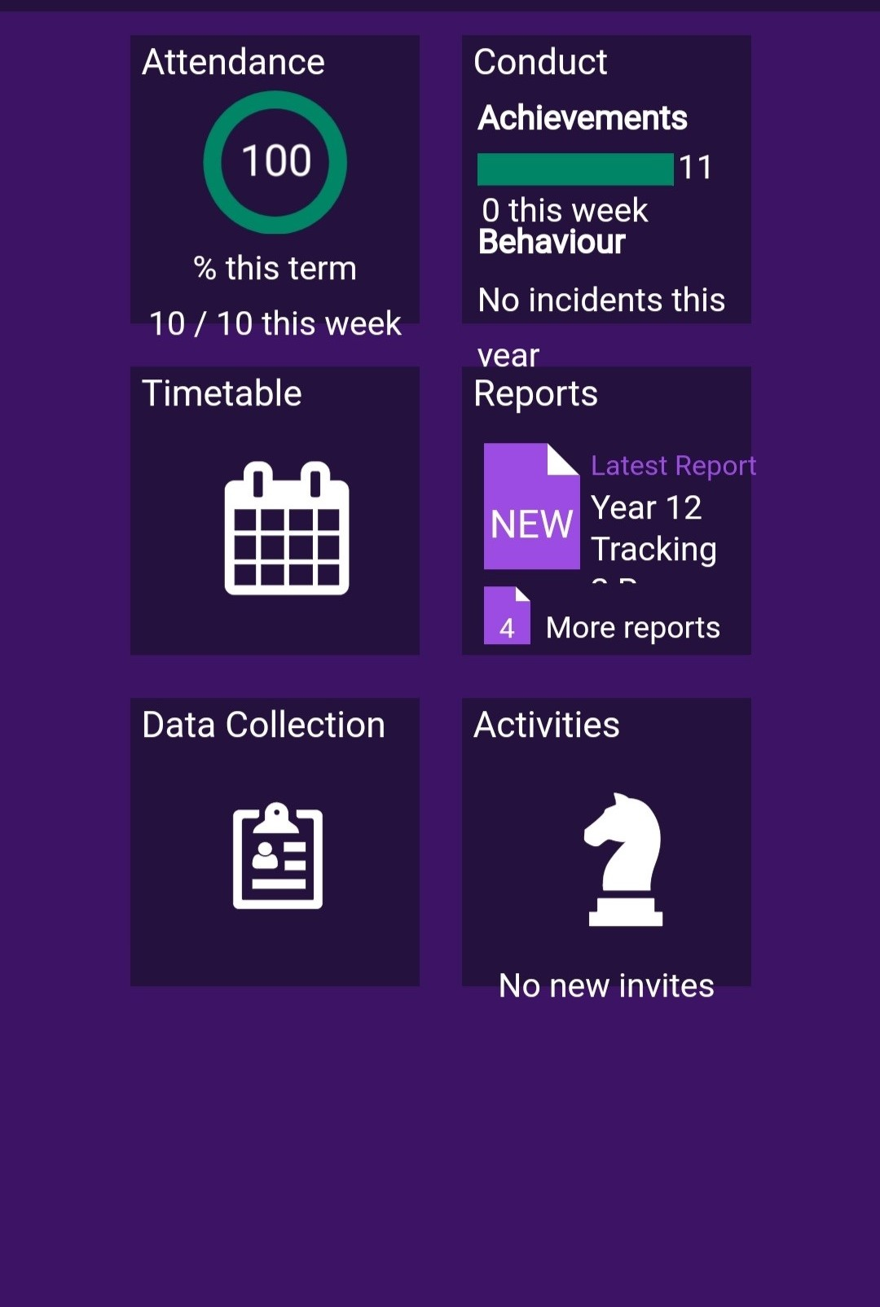
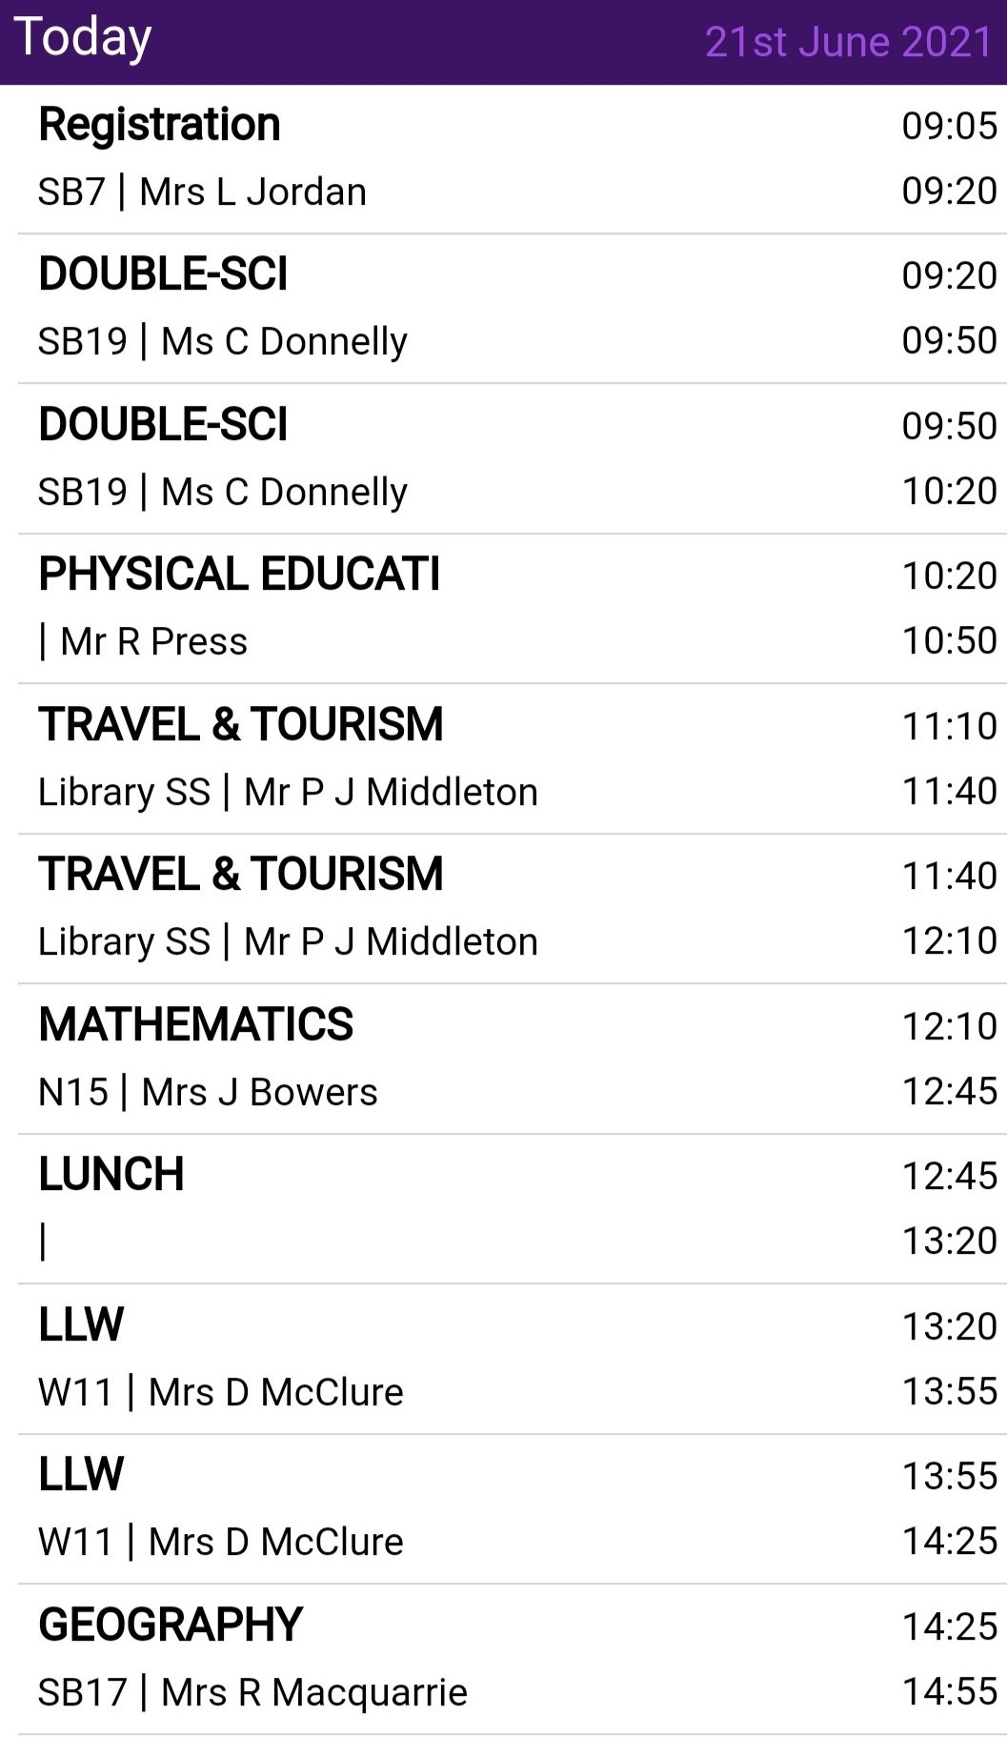
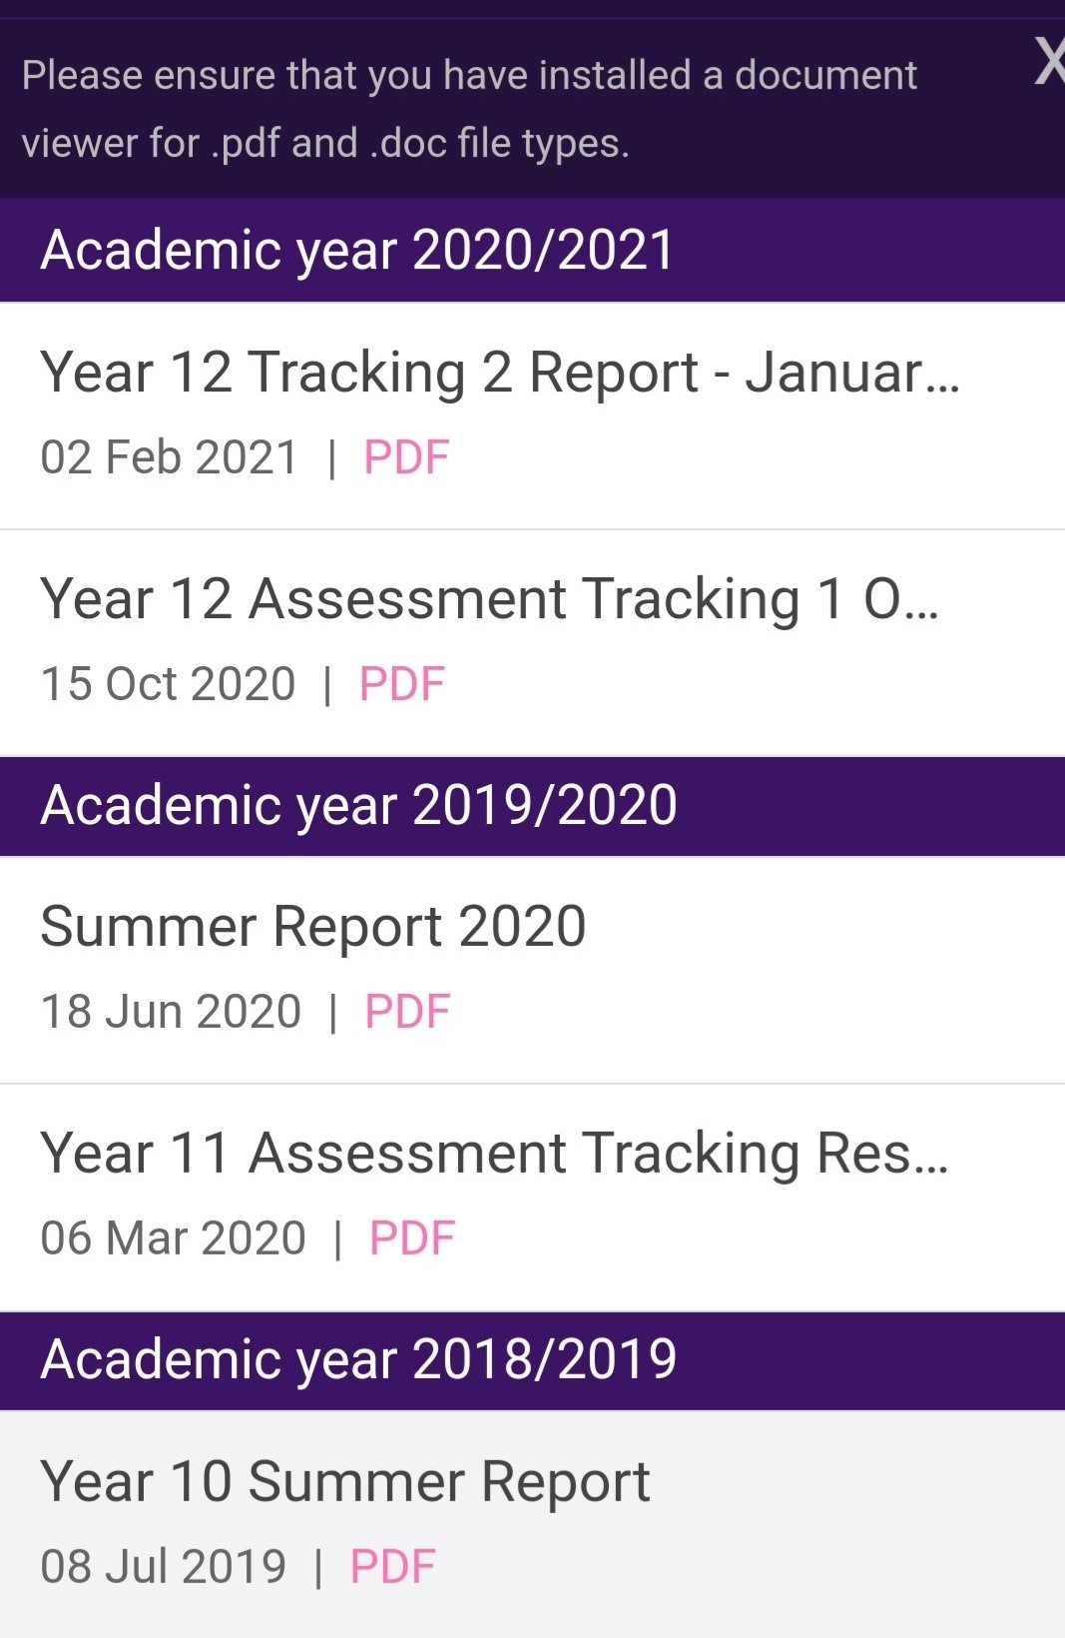
SIMs Parent App

Slide 17
Key Points
Sign Out – pupils will needs notes sent to school for an early sign out
Lateness – pupils will sign in at the office when late after registration
Absence notes – should be provided on return. Form available in student planners
Cash Canteen / Packed Lunch. Energy drinks and canned drinks are not permitted in school.

Slide 18
Key Points
You can communicate with us by: phoning school OR by emailing the school information account
info@carrickfergusacademy.carrickfergus.ni.sch.uk
Website and Facebook for other information

Slide 19
Finally
Any queries after tonight’s presentation, please email / phone school.
We will upload this PowerPoint and answers to queries to our School Website Home | Carrickfergus Academy
Please feel free to contact us to arrange individual visits for you and your child.
Once you have completed your Information Booklet in your Induction Pack, we would appreciate an early return to school – either office can be used.
Finally, have a lovely Summer and we will see you at 9am 26th August in full school uniform – bring a bag with your break.
THANK YOU

